Slide 1

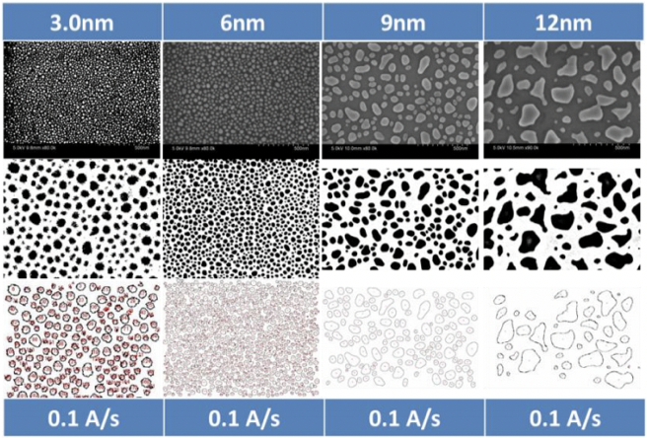
AI Image Analysis for Nanotechnology ——Project Application for SRTP
Advisor Prof Huan Hu
Prof Mark D.Butala
Student Jieting Chen
Yiqun Niu
Yue Feng

Slide 2
Introduction of Project Team

Slide 3
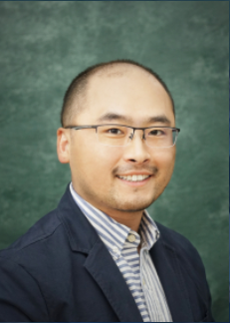

Introduction of Project Team —— Advisor
Huan Hu
assistant professor
Expertise in Micro/nanomanufacturing and biomimetic sensors and micro/nanofluidics
Butala D.Mark
assistant professor
Expertise in
image reconstruction and tomography statistical signal and image processing theory and application

Slide 4
Introduction of Project Team —— Student
Chen Jieting
ECE sophomore of ZJUI
Have participated in the research project of music emotional light effect system.
Niu Yiqun
ECE sophomore of ZJUI
Have participated in a research project on microstrip.
Feng Yue
ME sophomore of ZJUI
Have participated in the research project of the biped robot.

Slide 5
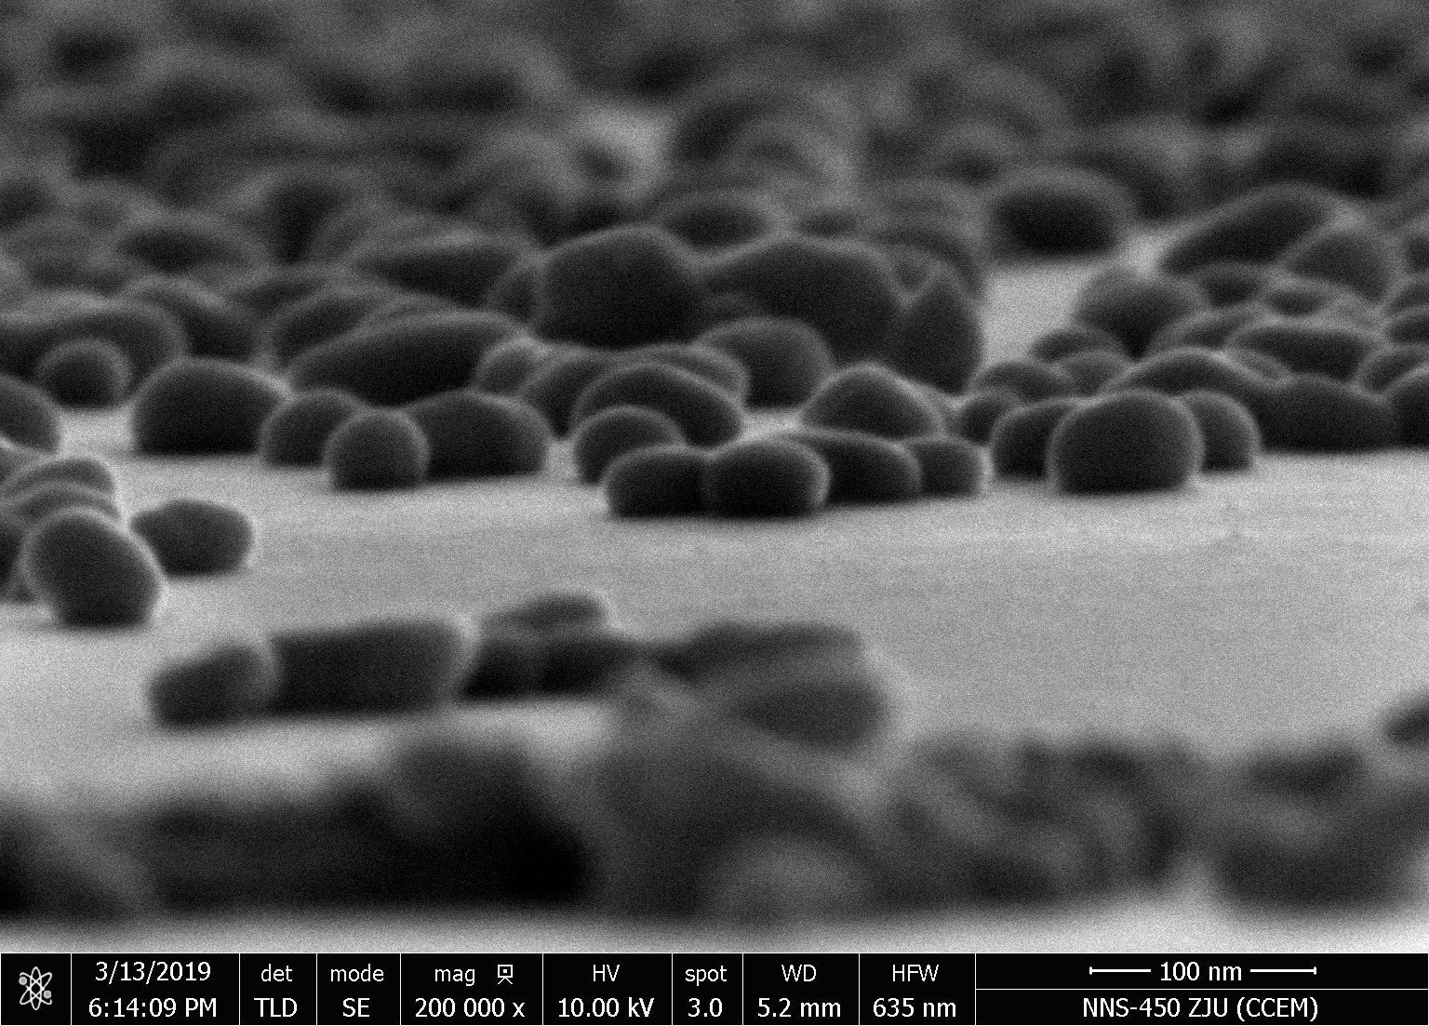
Introduction of Project Team —— Project
First step:
use atomic force microscope to obtain the samples images of nanoparticles
Second step:
develop a basic artificial intelligence algorithm to improve the efficiency of image analysis

Slide 6
Project Background and Purpose
1
2
Research Details
CONTENTS
3
Project Plan
4
Creative Ideas
Excepted
Achievement
855

Slide 7
1
Project Background
and Purpose

Slide 8
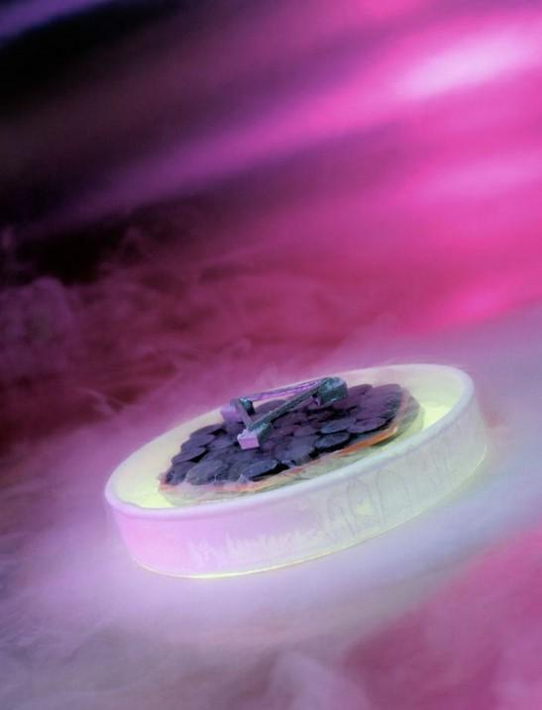
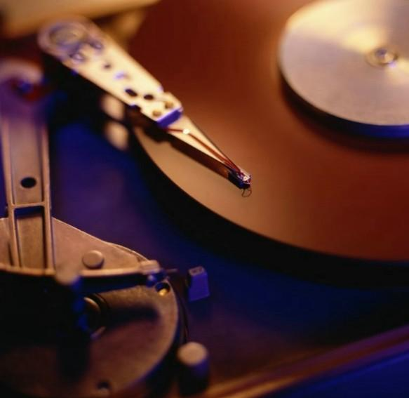
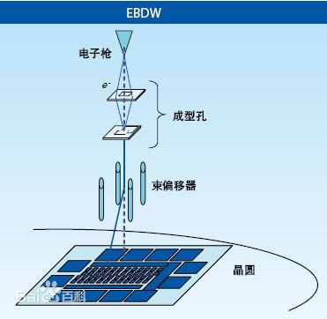
Project Background and Purpose——Background
Two existed methods to large scale fabrication of structures to 100 nanometers
Deep ultraviolet lithography disadvantage: The technology is expensive and can only be used to make semiconductor chips
Electron beam lithography disadvantage: The technology is slow, can not be widely manufactured, and the cost is high, it is difficult to widely used

Slide 9
Project Background and Purpose
Purpose
Explore a low-cost nanofabrication technology to produce silver nanoparticles by heating silver films
BUT
What’s the connection between the purpose and our project???

Slide 10
Project Background and Purpose
Make the purpose(or called the third method) practical and apply them in different aspects
Apply the template to produce large scale fabrication of structures to 100 nanometers
Find out the best conditions to produce silver nanoparticles template
Improve the efficiency to analyze process parameters
The ability to batch processing of nanoparticles images
AI analysis technology

Slide 11
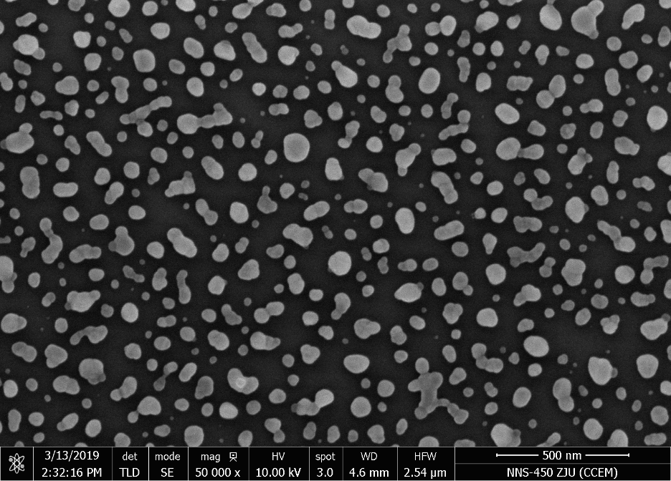
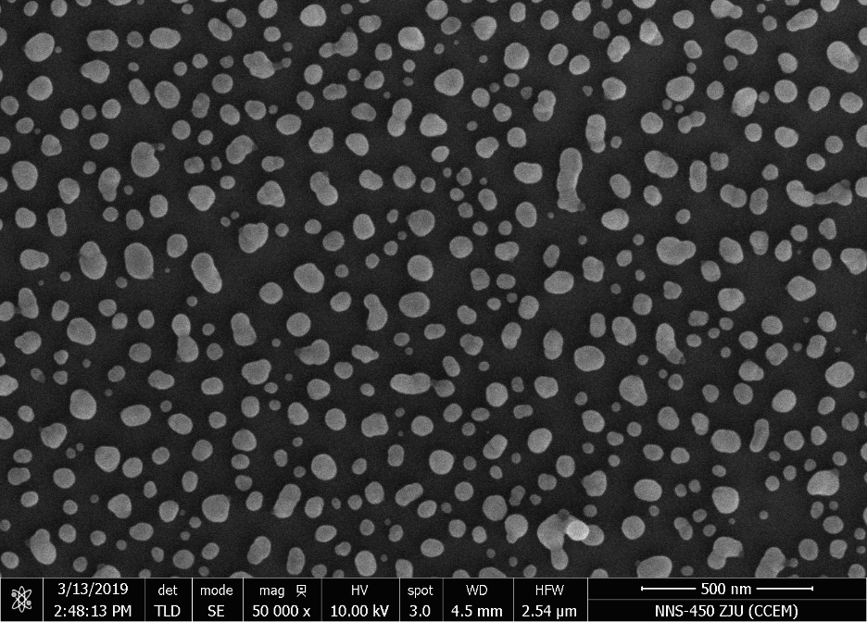
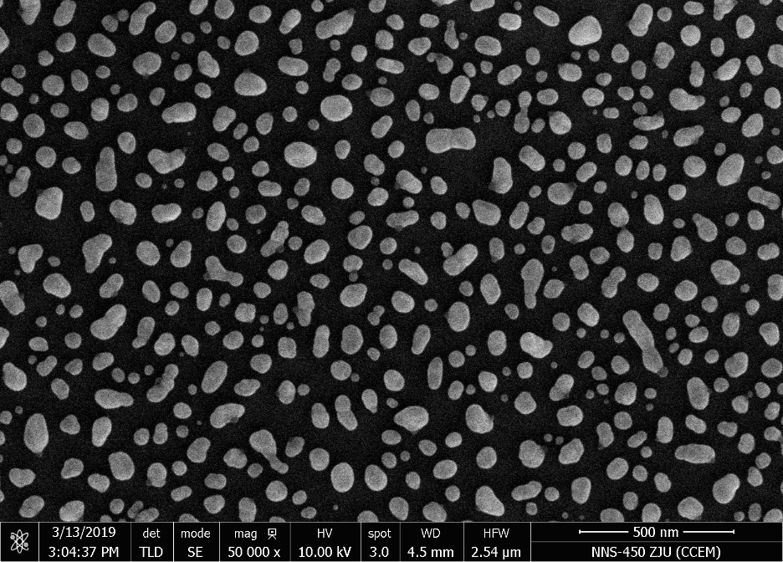
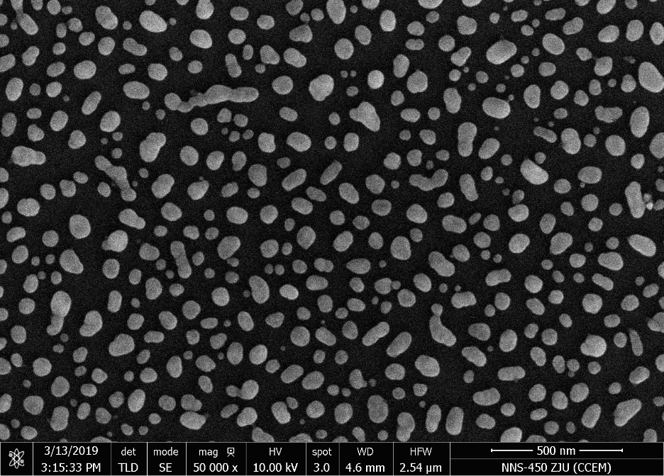
Different Temperature RTP (SEM 50000 x)
Condition Analysis for Temperature
10 nm Ag
120℃ 10min
10 nm Ag
240℃ 10min
10 nm Ag
360℃ 10min
10 nm Ag
480℃ 10min

Slide 12
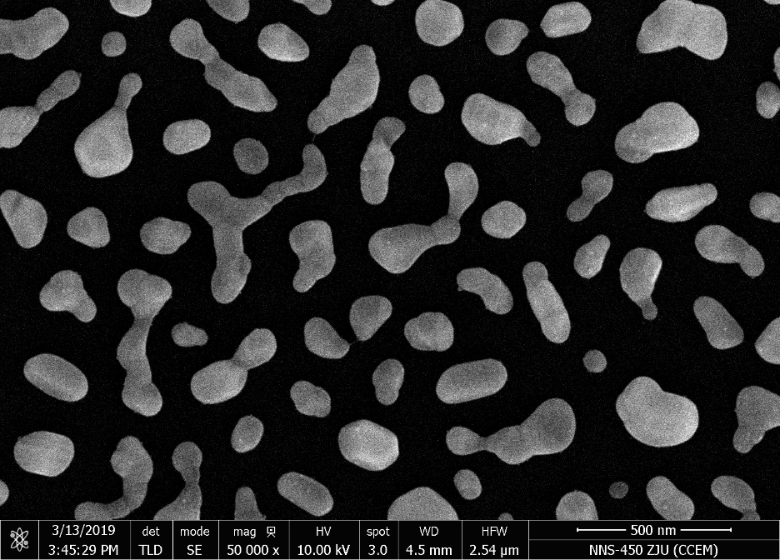
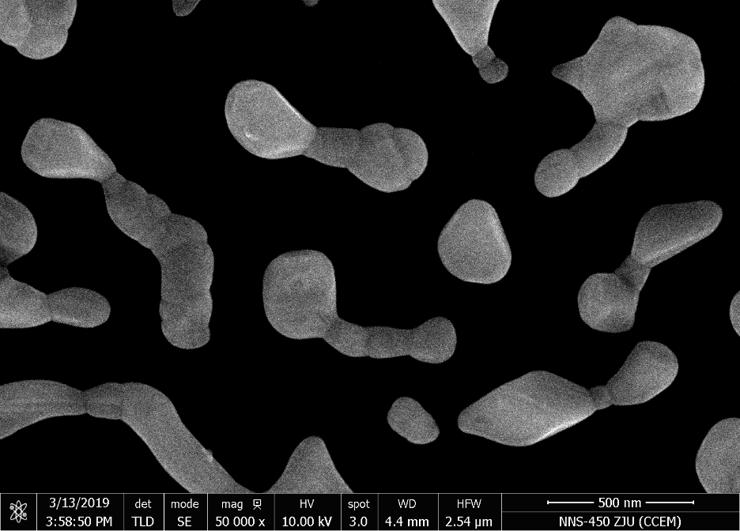
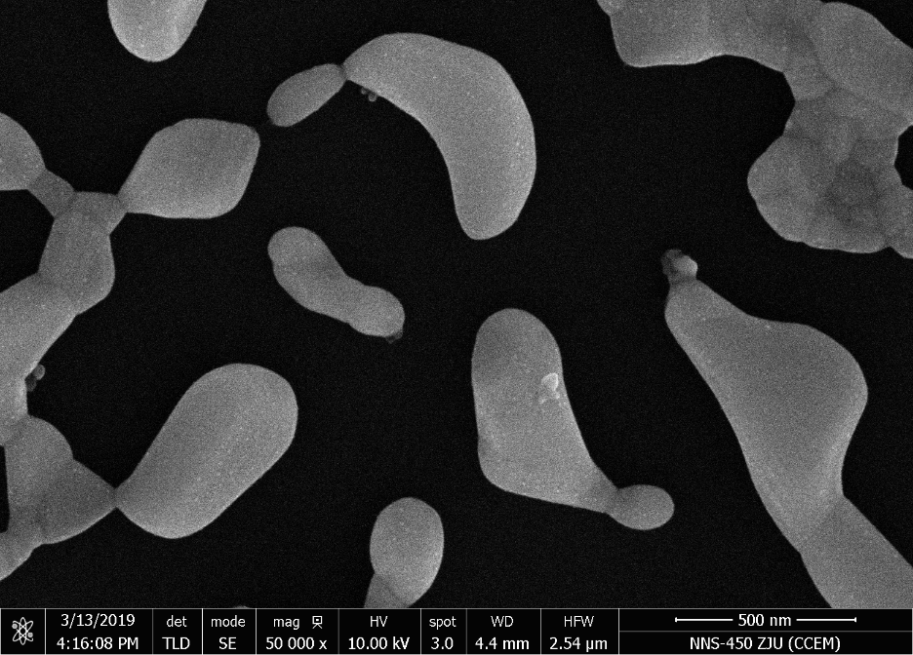
Different Thickness Silver (SEM 50000 x)
Condition Analysis for Thickness
10 nm Ag
480℃ 10min
20 nm Ag
480℃ 10min
30 nm Ag
480℃ 10min
40 nm Ag
480℃ 10min

Slide 13
2
Research Details

Slide 14
Research Details
Use atomic force microscope (AFM) to measure the samples of nanoparticles and scan the samples to obtain the morphological images of nanoparticles.
1
Use image analysis technology to process the images to obtain the size and number of nanoparticles, and the histogram of nanoparticles
2
Between above-mentioned two steps, a basic artificial intelligence algorithm program was developed to improve the efficiency of image analysis
3

Slide 15
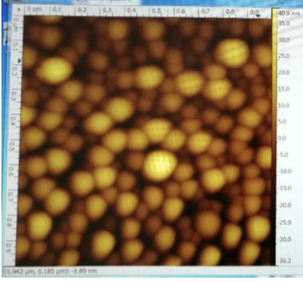
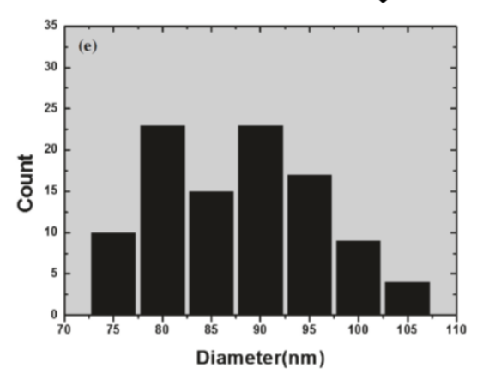
Research Details
the original method of utilization of open source software ImageJ
the batch processing of nano-particle images by artificial intelligence algorithm
First step
obtain the morphological images of nanoparticles.
Second step
Obtain the histogram of nanoparticles

Slide 16
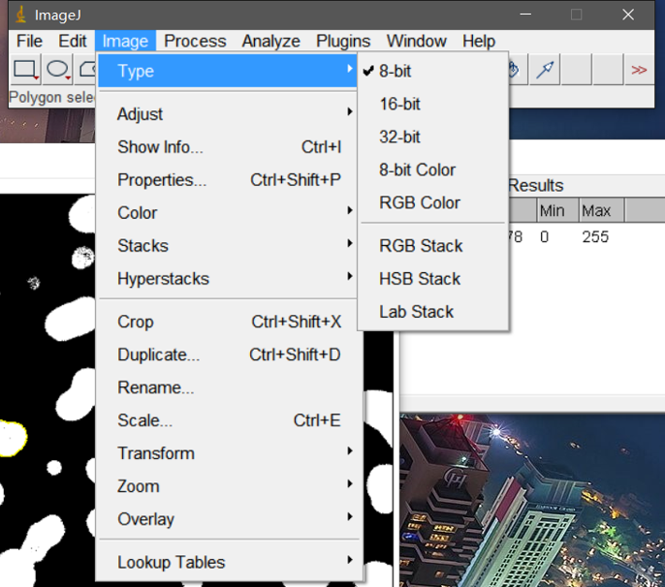
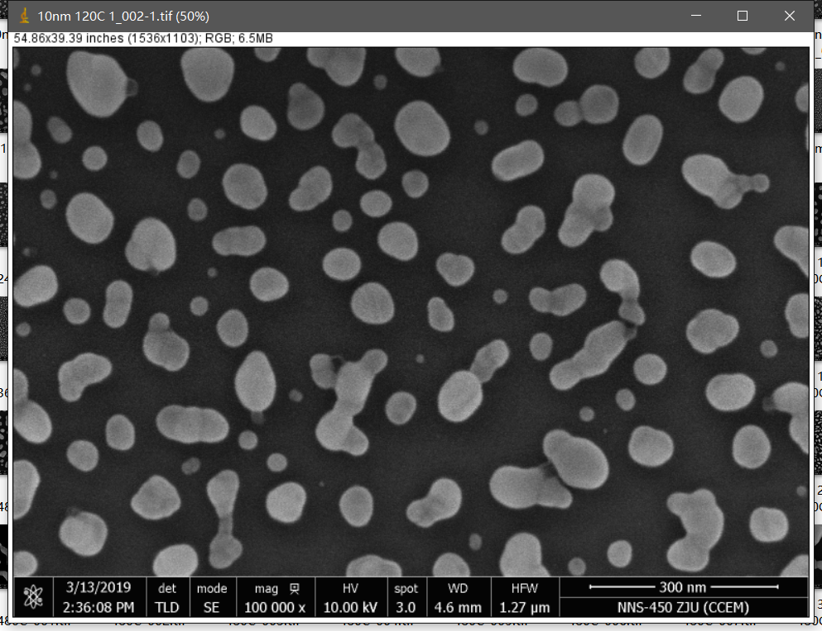
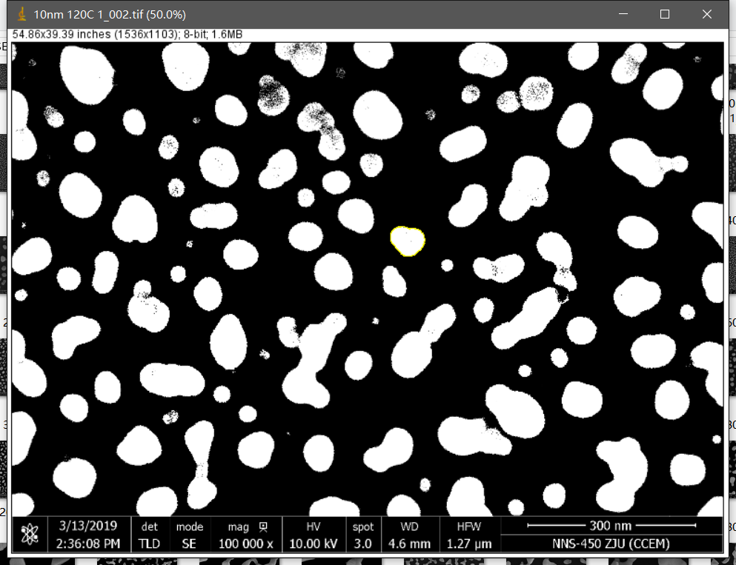
Use ImageJ to get the AFM Image

Slide 17
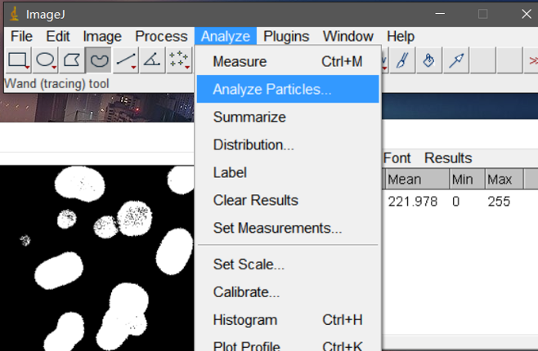
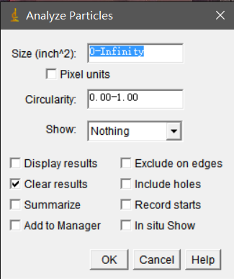
Use ImageJ to Find the Location

Slide 18
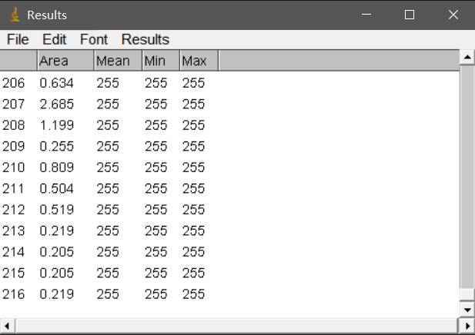
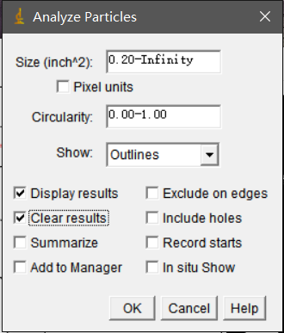
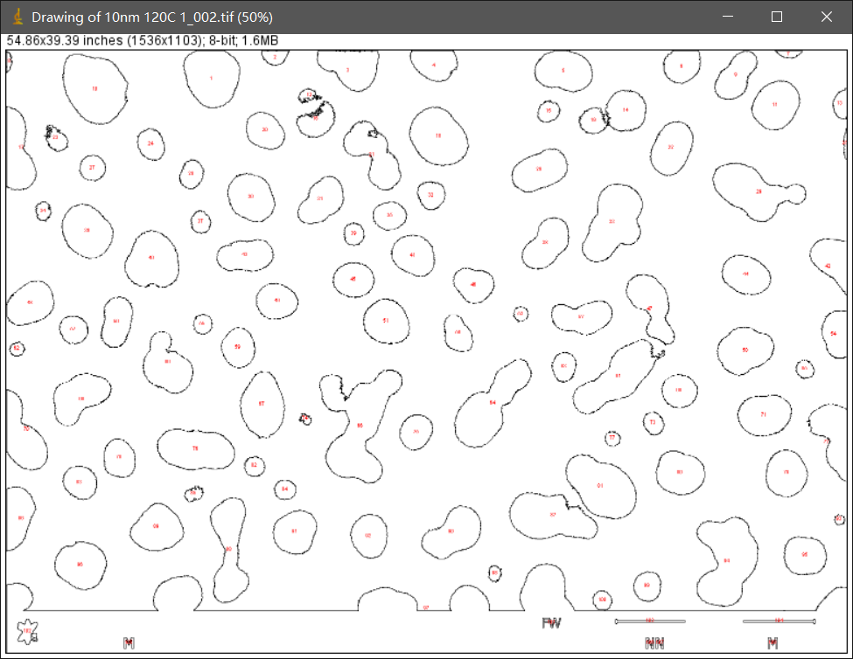
Transform Location to Data

Slide 19
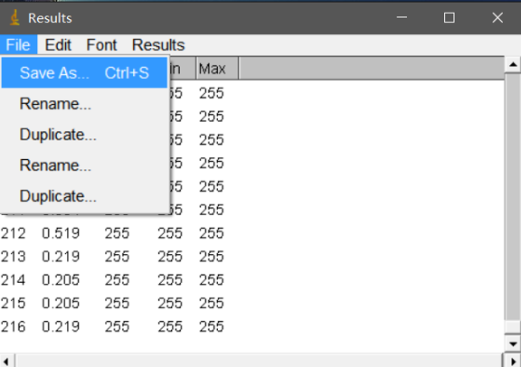
Analyze the Data

Slide 20
3
Project Plan

Slide 21

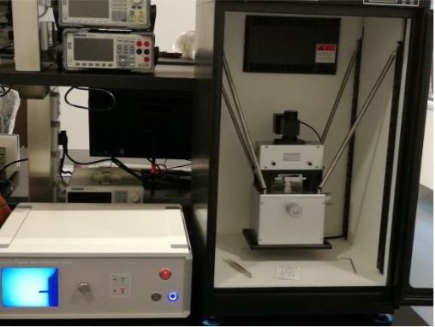
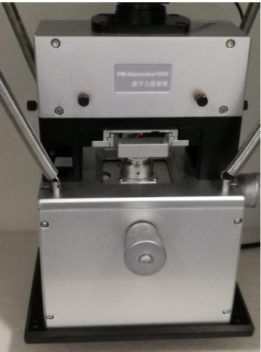
Project Plan
2019.3—2019.6
Practice to use FM-Nano-view 1000AFM proficiently
Learn to use ImageJ to process Nano-particle image manually.
01
2019.6—2019.9
Practice to be familiar with image processing software and technology
Learn basic AI principle
02
2019.9—2019.12
Develop an AI image processing technology, explore various algorithms, design and manufacture plug-in with appropriate algorithms
03
2020.1—2020.3
Write journal article
Participate in national conference
04

Slide 22
4
Creative Ideas

Slide 23
Creative Ideas
New image analysis technology – AI algorithm
Burgeoning aspect – Nano structure
BIG
IDEA
Reduce cost and mass production

Slide 24
5
Expected Achievement

Slide 25
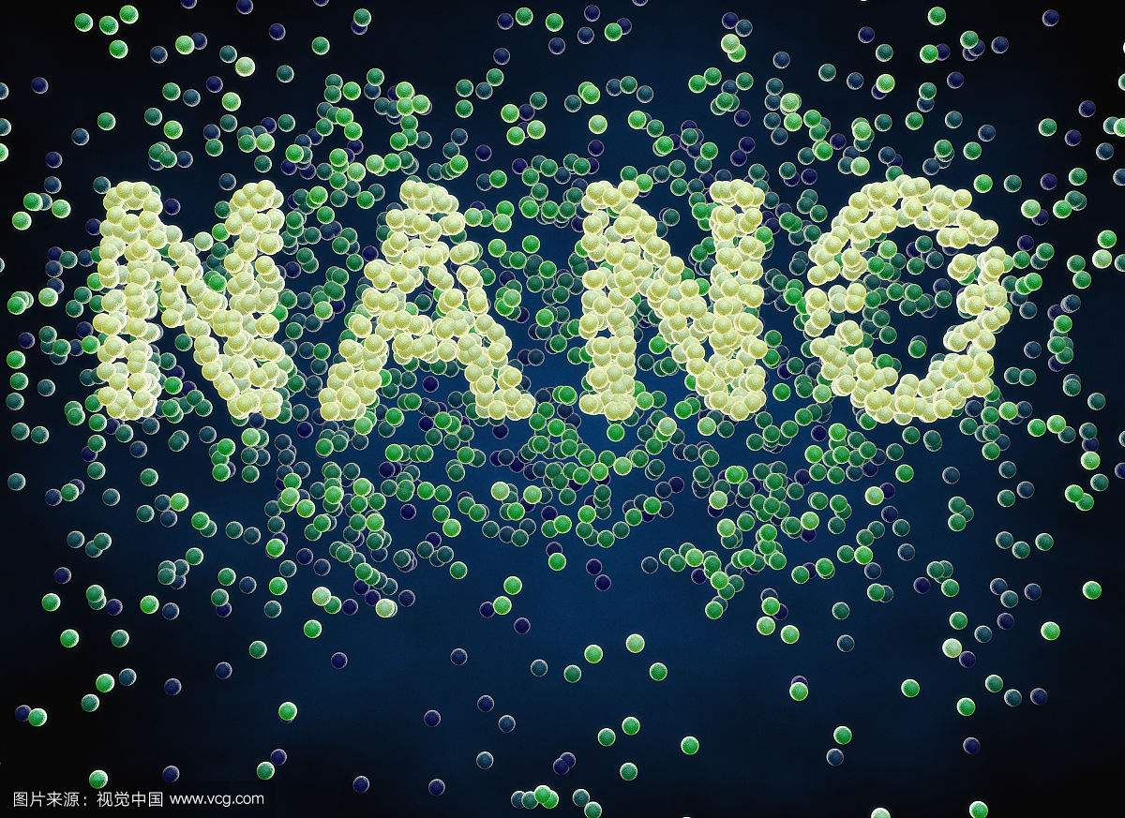
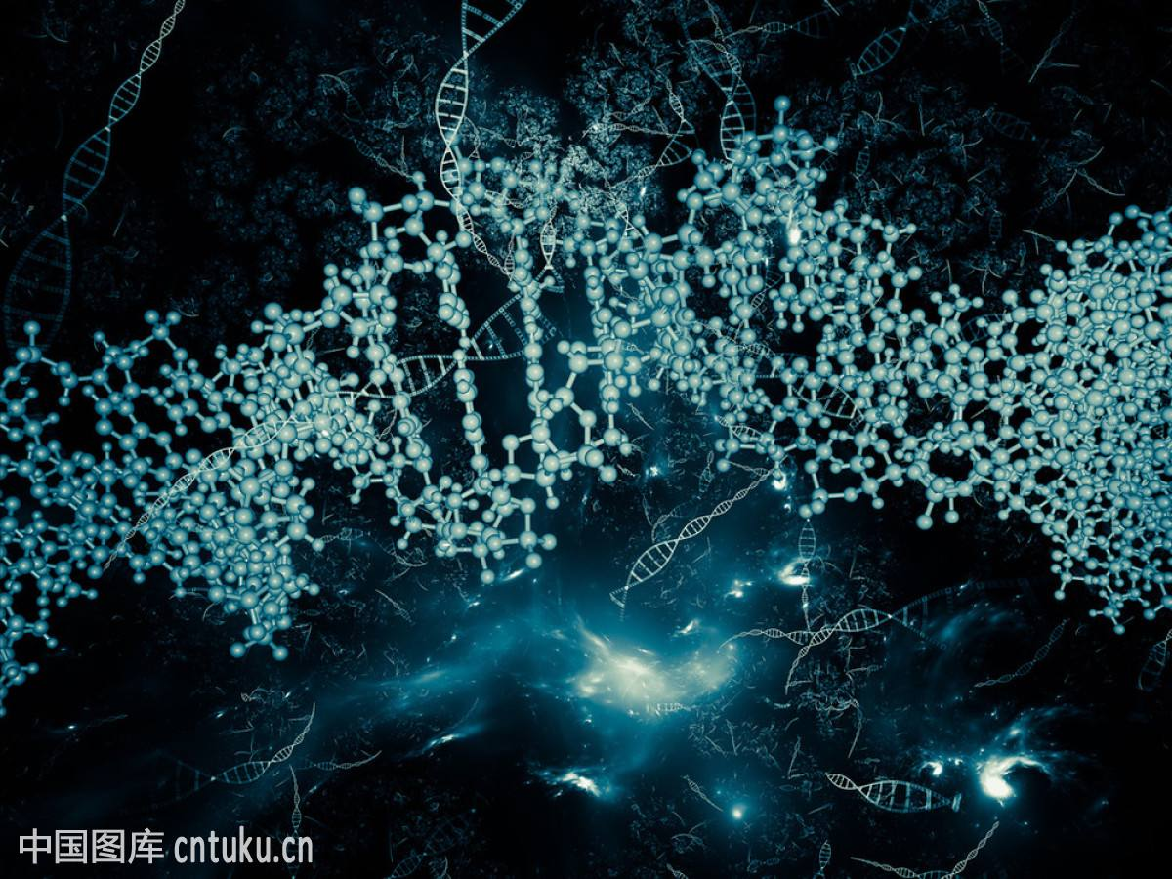
Expected Achievement
01
Developing a software or plug-in which can improve the efficiency of Nano-image processing
Using the developed software of plug-in to get valuable data, which can lead to find the optimal technological parameters. In this way, it can improve the development of Nano-manufacturing technology in low cost and on a large scale.
02
03
Participating in conference or public journal articles.

Slide 26
THANK YOU

